Slide 1
Transport Knowledge Hub Webinar Series 2020
30 November – 4 December 2020
Safe System Case Studies
Maria Drinkwater, Waka Kotahi and Colin Brodie, Road Safety Consultant
The views and opinions expressed in this presentation belong solely to the presenter(s), and do not necessarily reflect the views of the presenter’s employer, TKH, or any other group or individual
Notes:
Hi – Intros/Roles:
Maria – leading wider capability support, of which this is part of it. And embedding SS principles into our business.
Colin – Case study identification, and technical review and guidance and knowledge of the Safe System journey for NZ over the last decade. Q&A – add to chat if needed.
The purpose of this short presentation is to update you on a project we kicked off with the ultimate aim of producing a range of case studies that highlight successful application of the safe system principles.
Whilst acknowledging this isn't a fully completed project as yet, we thought still what a great opportunity to share the work started so far and shine a light on a few examples and share our plans to grow these case studies over time.
This isn’t a deep dive into a full intensive research project, but instead a chance to inform yu on the project and what you can expect to see.

Slide 2
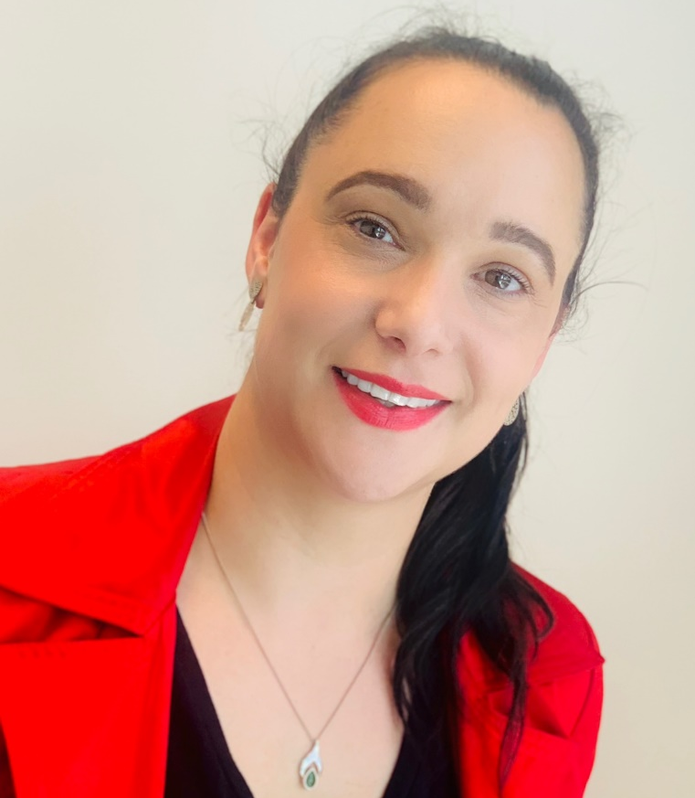
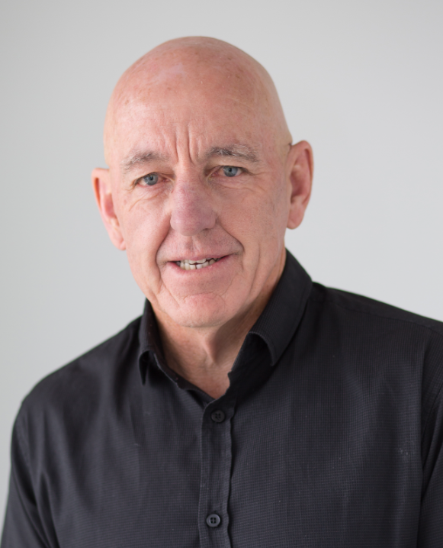
Introduction
Maria Drinkwater, Waka Kotahi
Colin Brodie, Road Safety Consultant
Maria Drinkwater
Colin Brodie

Slide 3
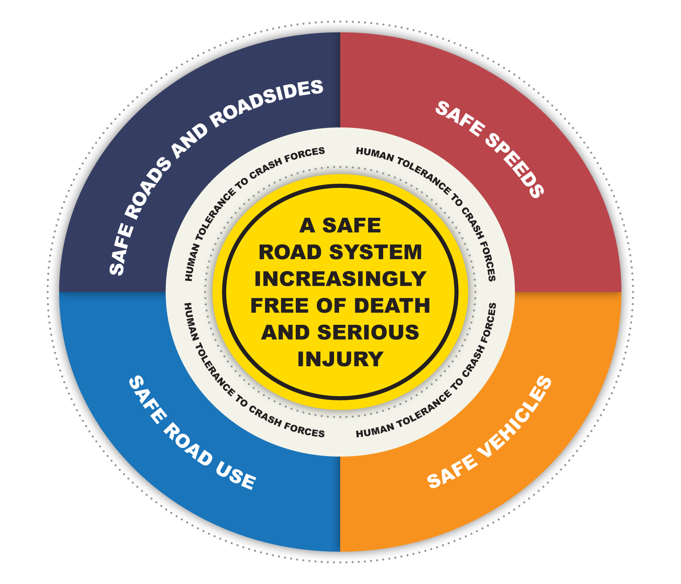
Road Safety evolution in Aotearoa over the past decade

Slide 4
The Safe System approach is how we will reach Vision Zero
Design for people
A system response

Slide 5
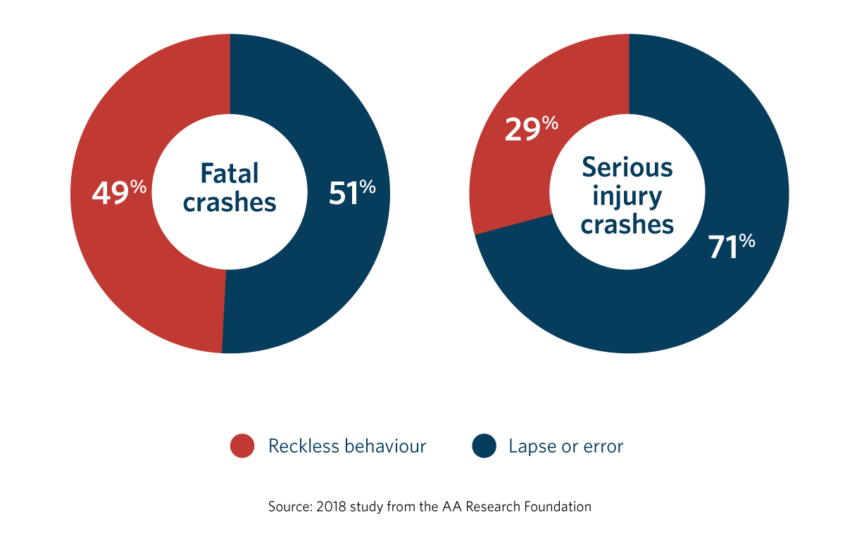
Accepting we are human

Slide 7
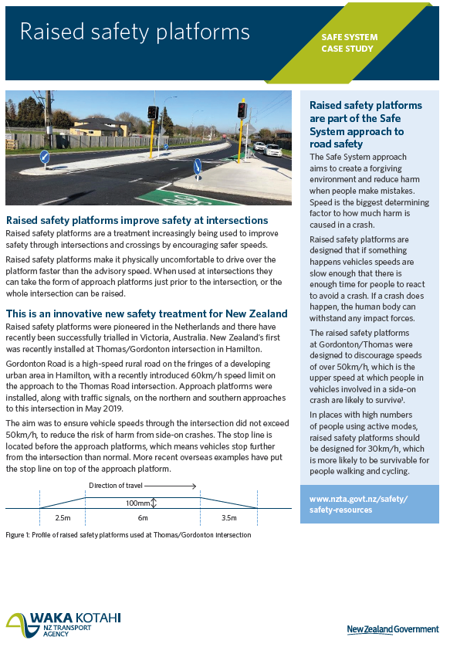
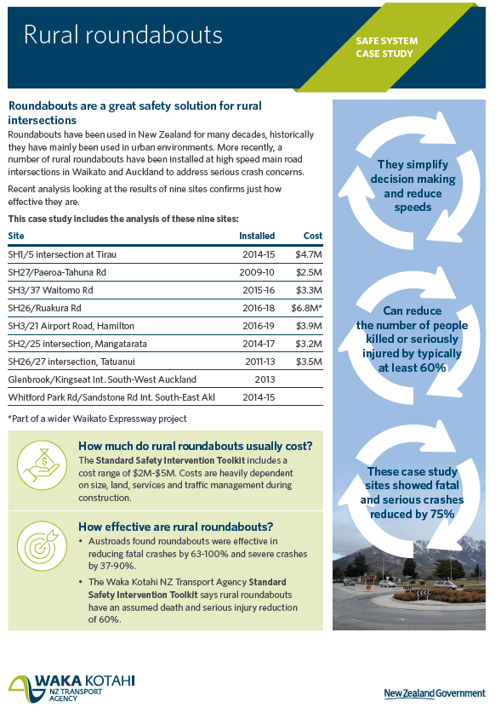
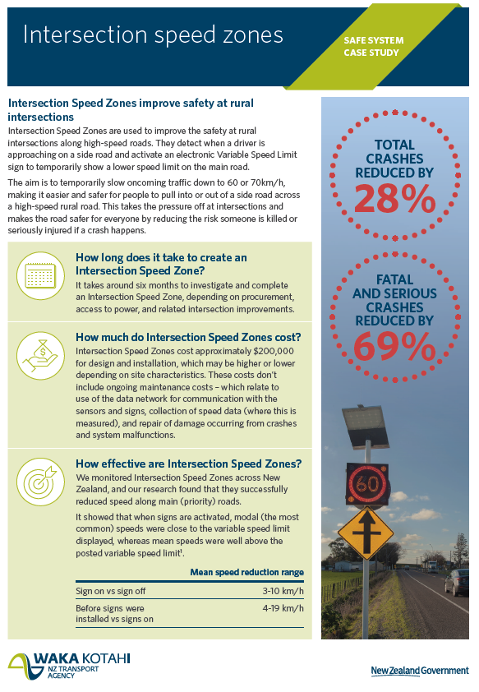
First Case Studies to be published

Slide 8
Coming soon!
Coming next…
Visiting Drivers Partnership
CBD urban speed reduction - Christchurch
Tactical Urbanism, Sale Street
Mangere Future Streets project
Median barriers
Rural speed reduction
Workplace H&S – site safety initiatives
We are always looking for more candidates, we need examples all across the system response

Slide 9
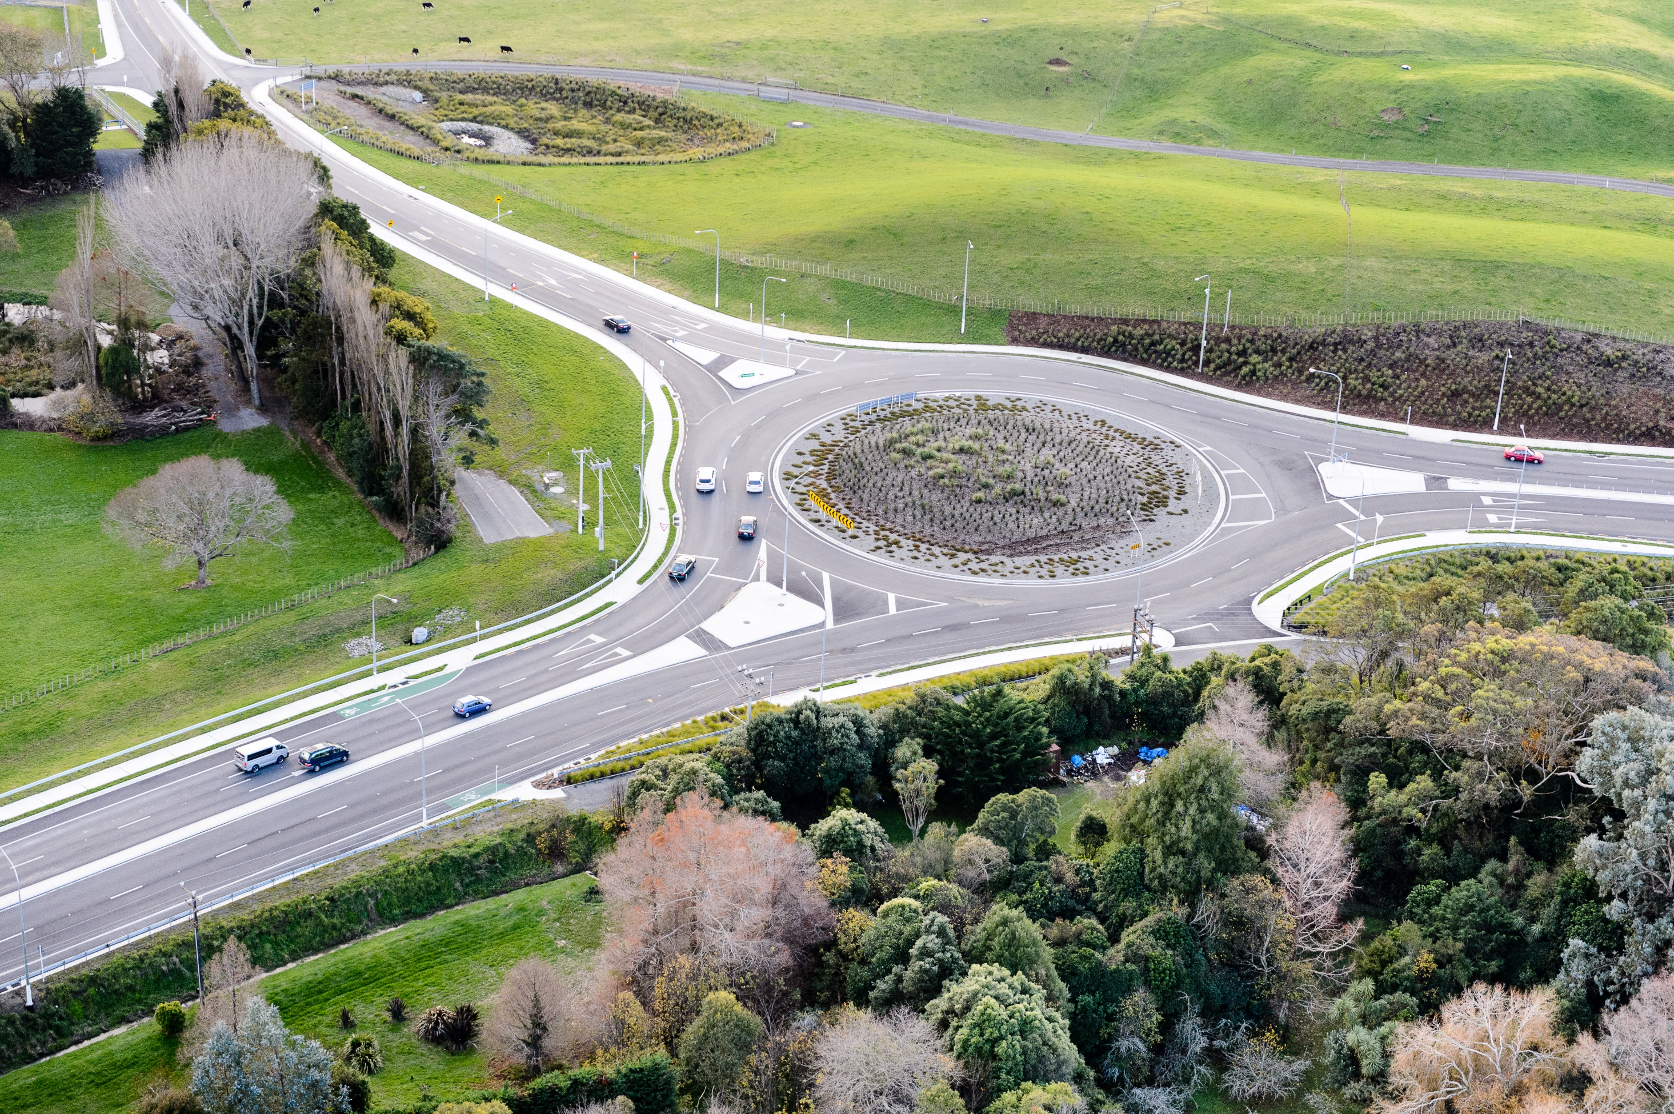
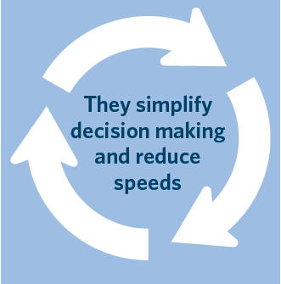
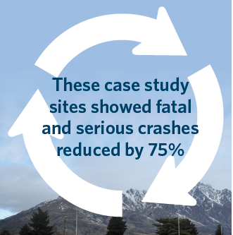
Rural RoundaboutCase Study

Slide 10
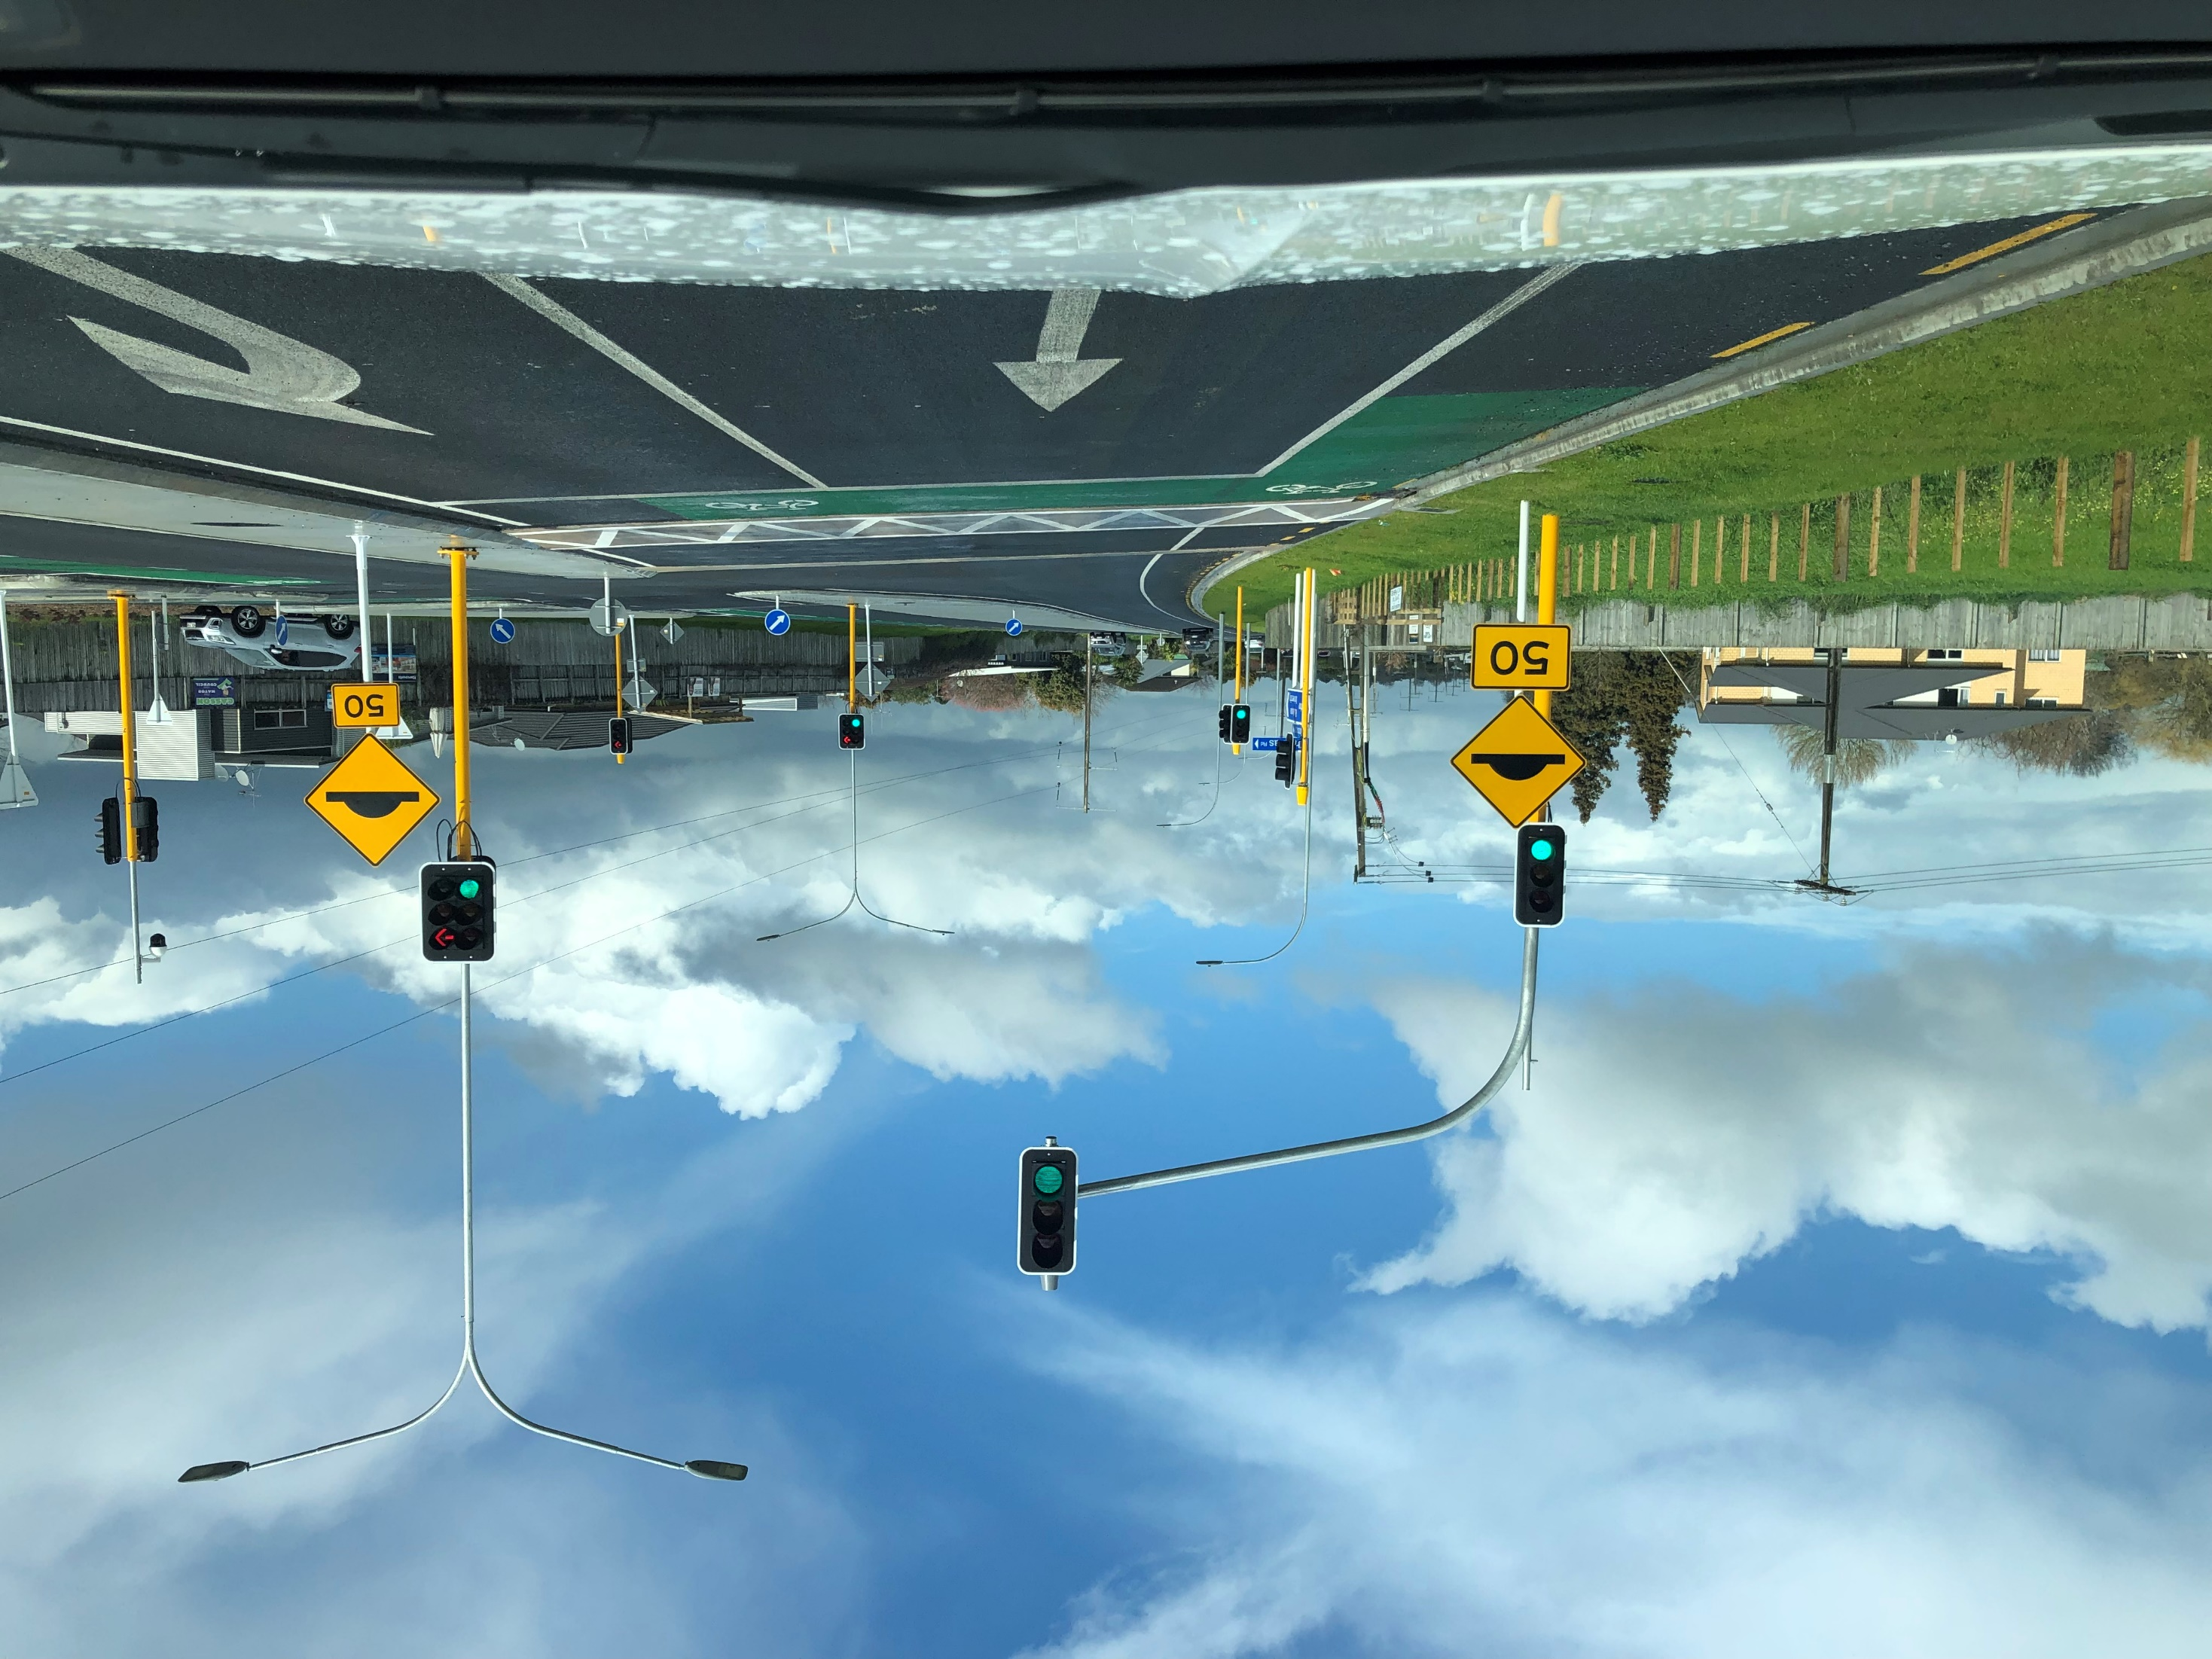
Raised Safety Platform Case Study

Slide 11
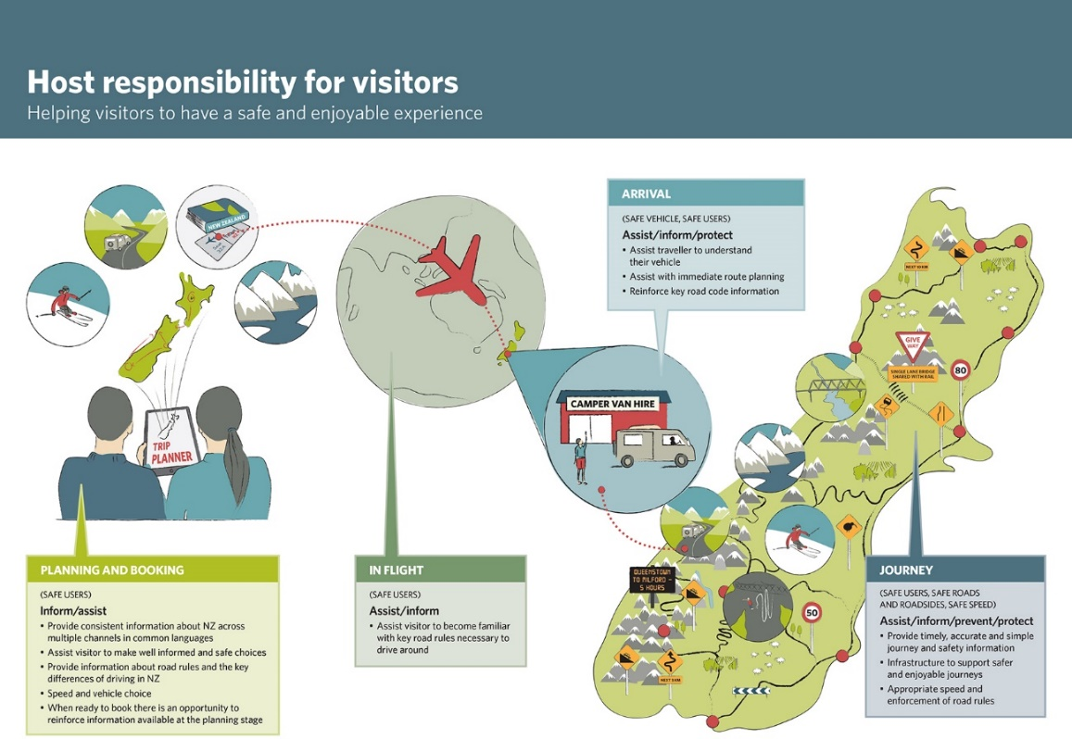
Visiting Drivers Partnership

Slide 12
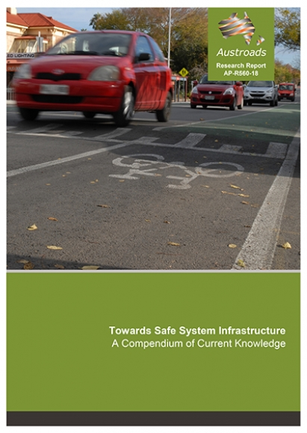
Some key documents referenced in many of the case studies

Slide 13
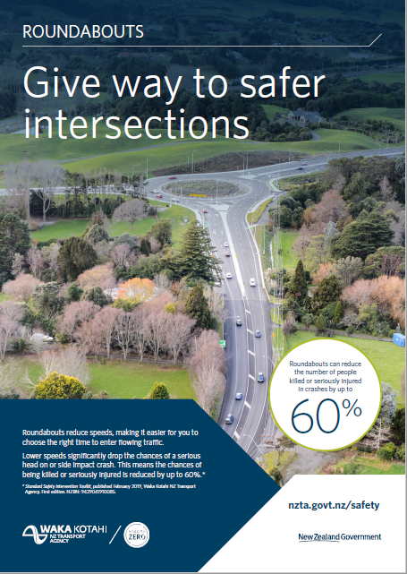
We also have simplified material on our standard safety interventions
Posters and brochures to use at public engagements and community events.
Showing the public how our standard safety interventions help save lives and improve road safety.

Slide 14
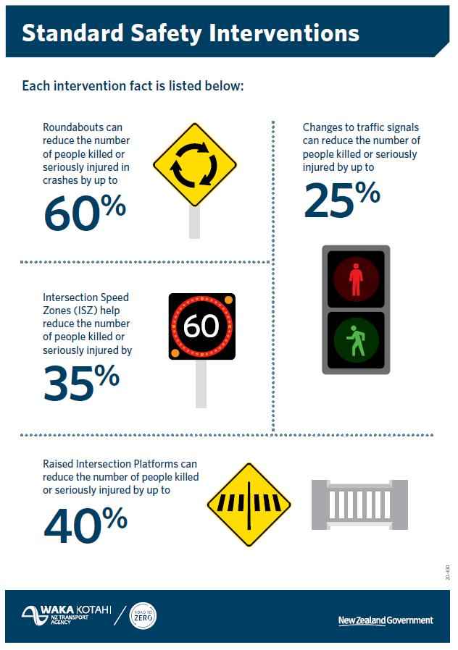
Some great simple material
To find these and more,
visit our website:
nzta.govt.nz/
safety/nz-road-safety-strategy/safe-network-programme/safety-interventions/

Slide 15
Look out soon for our updated resources page!
We are updating our safety section on Waka Kotahi’s website
Case Studies – going live very soon.
Short videos designed to support Vision Zero conversations with different groups of road safety practitioners in local communities
Updated Vision Zero tips for range of system designers
Coming next year – Vision Zero interactive e-learning modules
https://www.nzta.govt.nz/safety/safety-resources/

Slide 16
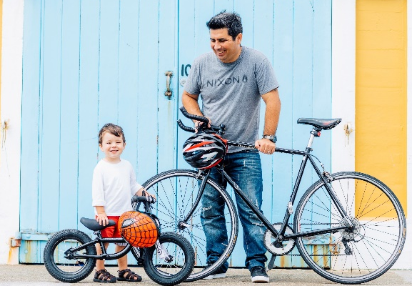
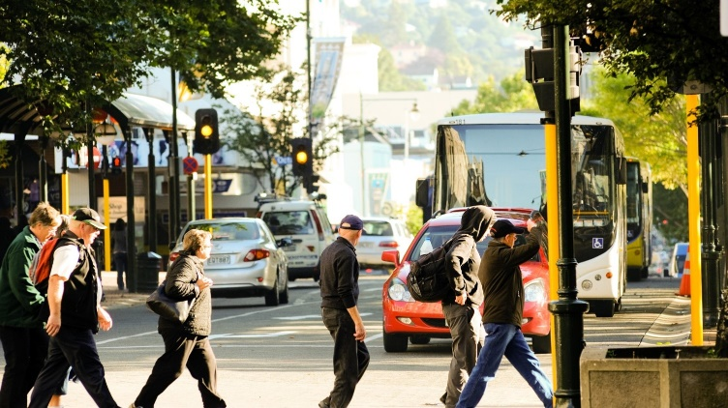
Questions?

